Slide 1
10th week
Hayriye hilal tepecik

Slide 2
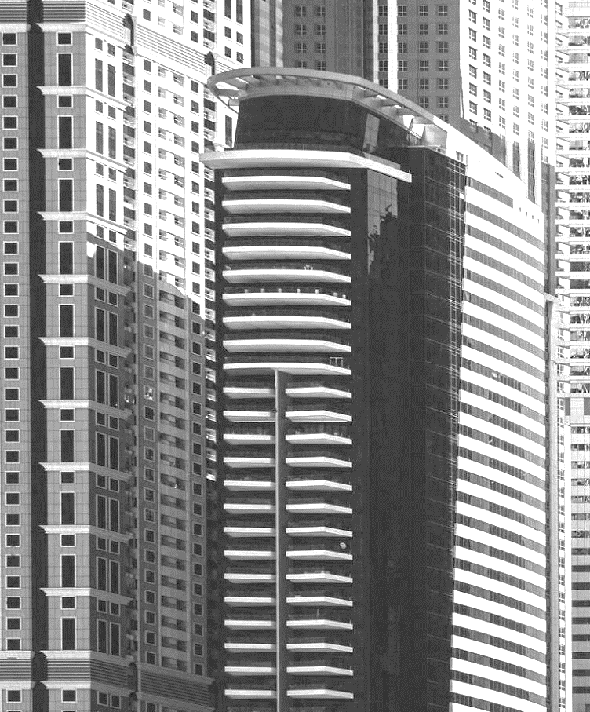
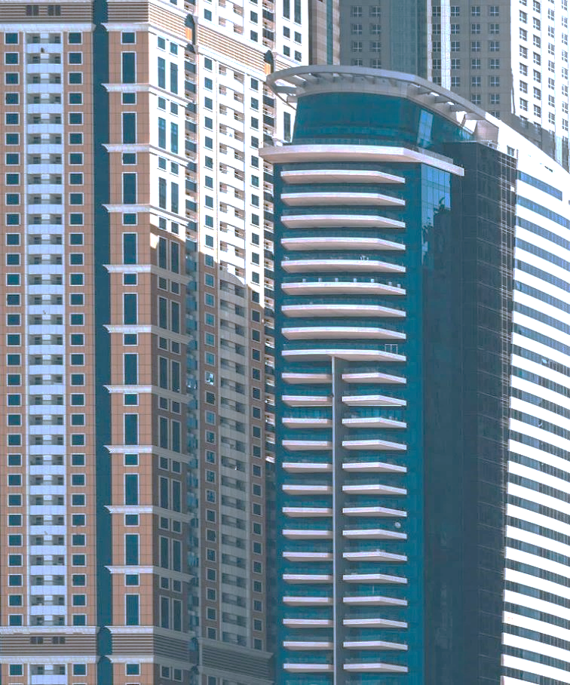
AGENDA
INTRODUCTION
Game Desıgn
Level desıgn
Render Pıpelınes
Lights
Fog
Skybox
Shader
Effects
Conclusion

Slide 3

INTRO
Who am I?
-Huawei (November 2022)
-IronheadGames
-Wakett(Malta) Ltd. (Intshp)
-Maynooth University (Intshp)
Abant Izzet Baysal University
– Computer Engineering (Bc’s)

Slide 4

Introductıon to Game Desıgn
Game design is the foundation of creating engaging and enjoyable games. Game design encompasses the creation of a game's rules, mechanics, narrative, and overall structure. A well-designed game provides a compelling experience that keeps players coming back for more.

Slide 5
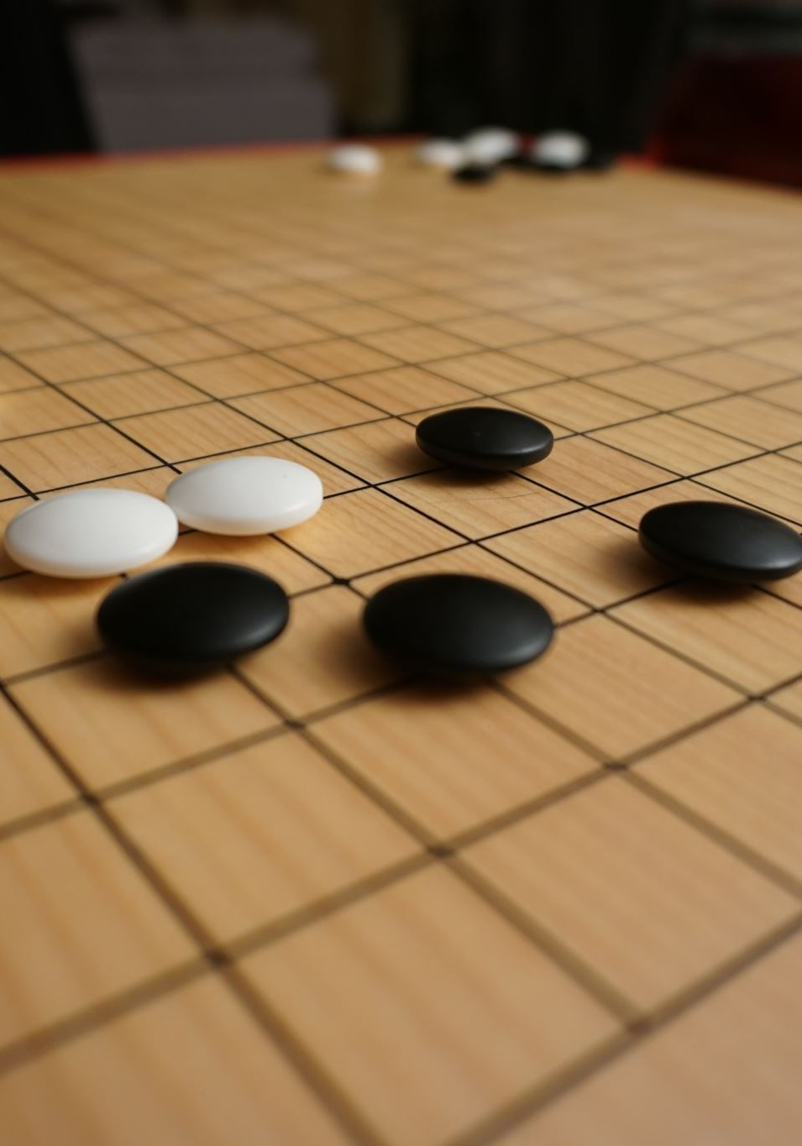
Importance of Game Design
Game design is crucial to the success of a game. A game with solid design principles will be enjoyable to play and more likely to resonate with players on an emotional level. A well-designed game can create memorable experiences, foster social connections, and even evoke strong emotional responses from players.

Slide 6

Core Elements of Game Design
Mechanics: These are the rules and systems that govern how a game works, such as movement, combat, or resource management.
Narrative: The story or context of a game, which can provide a sense of purpose, motivation, and immersion for players.
Aesthetics: The visual, auditory, and tactile aspects of a game, which contribute to its overall look, feel, and atmosphere.
Balancing: Ensuring that all game elements are fine-tuned to create a fair and enjoyable experience for players.

Slide 7
Game Design Principles
Player choice: Giving players meaningful choices and the freedom to make decisions can lead to more engaging and replayable experiences.
Clear goals: Providing players with clear goals and objectives helps guide their actions and maintain their interest.
Challenge and progression: Balancing the difficulty of a game and gradually increasing challenges can keep players engaged and motivated.
Feedback and rewards: Offering feedback on players' actions and rewarding their progress can create a sense of accomplishment and encourage continued play."

Slide 8
Examples of Well-Designed Games

Slide 9
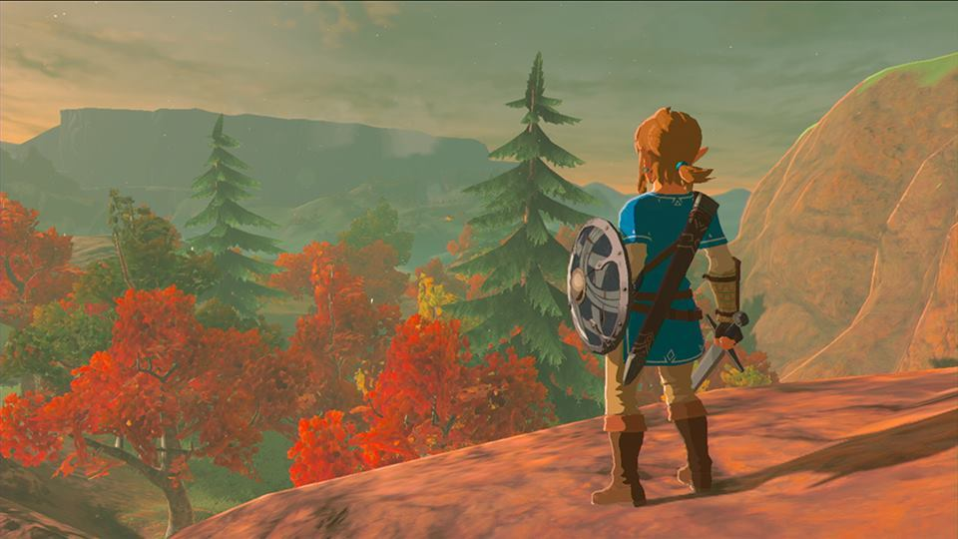
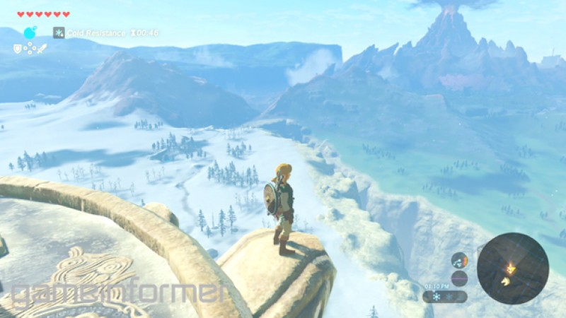
Examples of Well-Designed Games
The Legend of Zelda: Breath of the Wild - This game offers a vast open world with numerous choices, challenges, and a rich narrative that keeps players engaged.

Slide 10
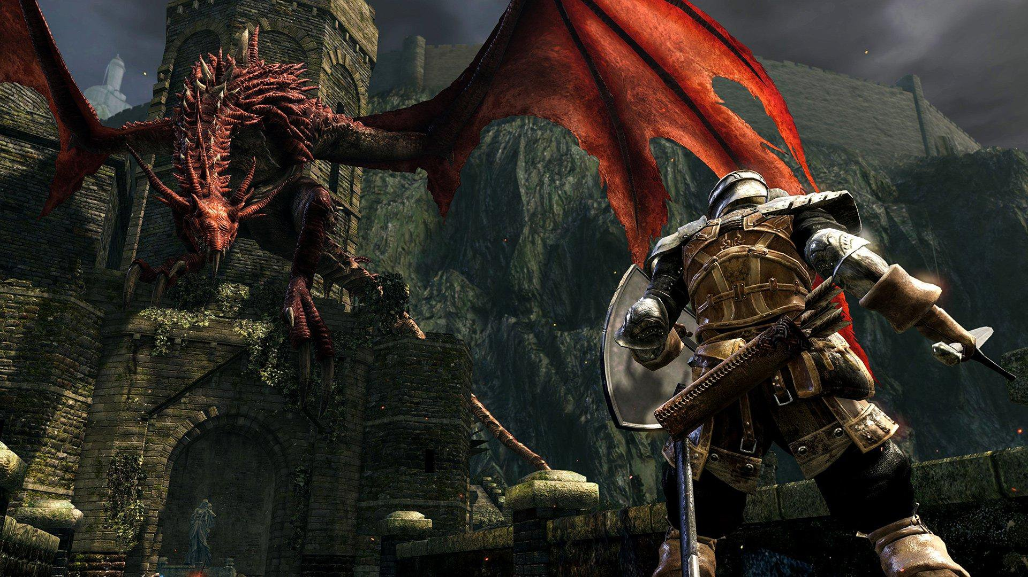
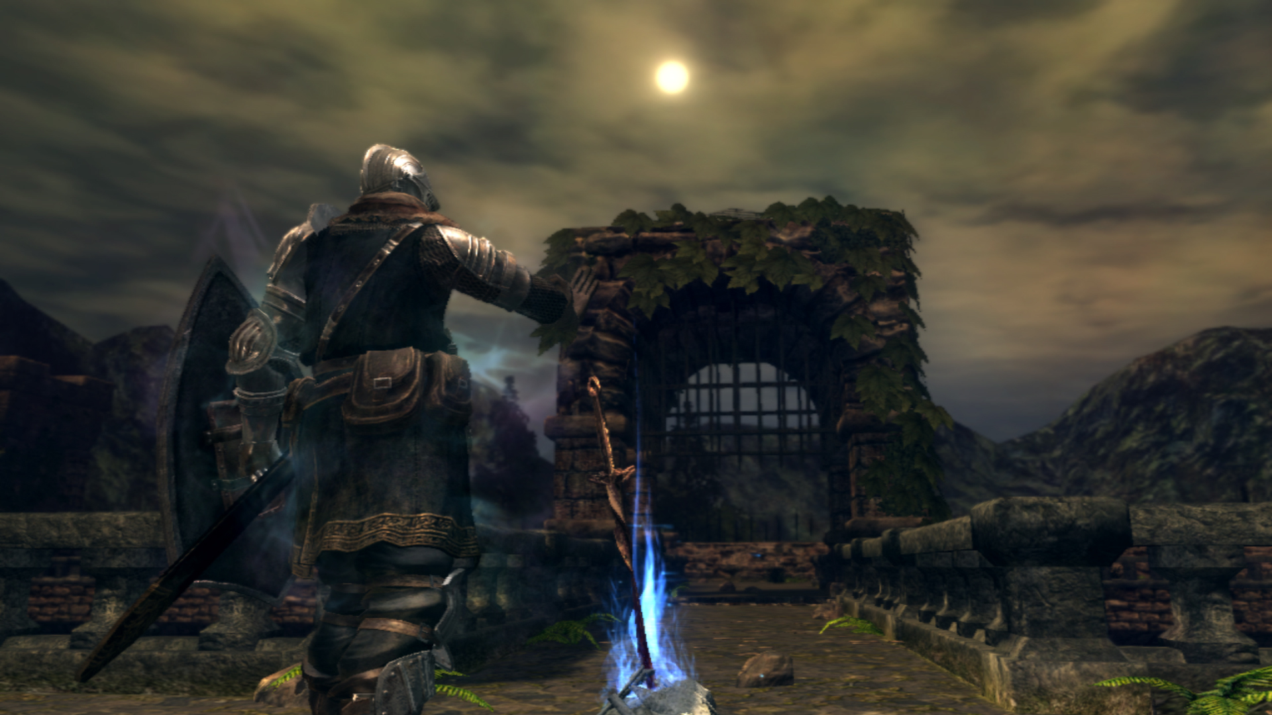
Examples of Well-Designed Games
Dark Souls - Known for its challenging gameplay and deep lore, Dark Souls provides a rewarding experience for players who persevere through its difficult encounters.

Slide 11
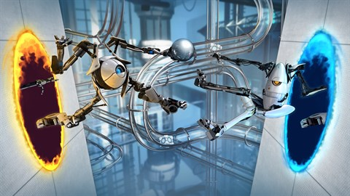
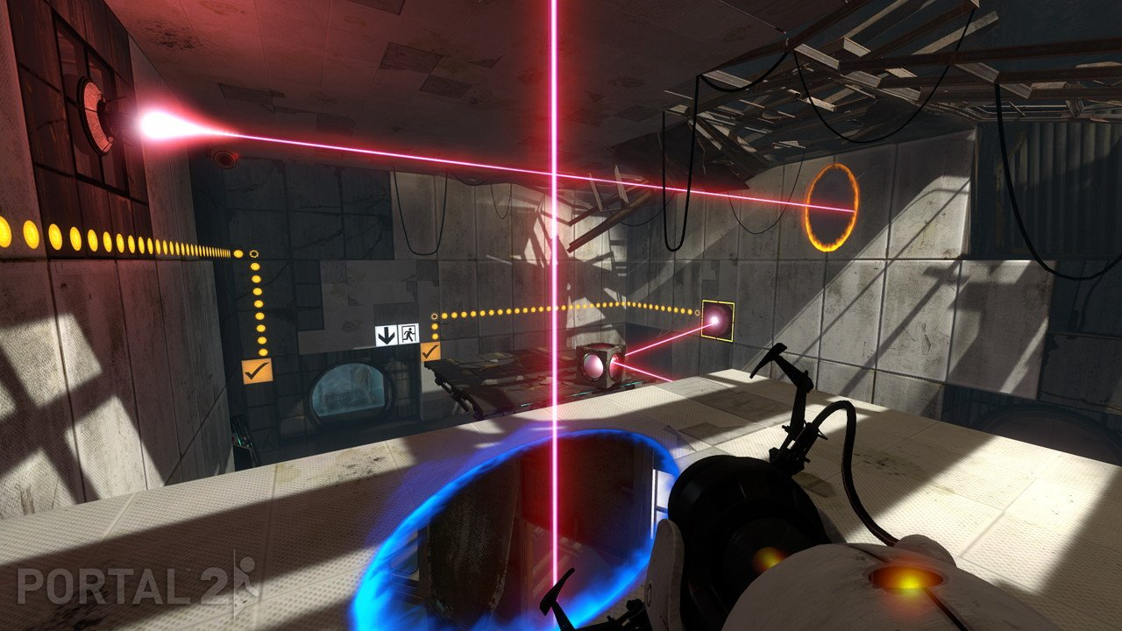
Examples of Well-Designed Games
Portal - Combining innovative mechanics, engaging puzzles, and a compelling narrative, Portal offers a unique and memorable gameplay experience.

Slide 12

Conclusion of game desıgn
In conclusion, game design is a critical aspect of game development that significantly impacts the overall player experience. By considering elements such as mechanics, narrative, aesthetics, and balance, we can create games that resonate with players and provide memorable, engaging experiences.

Slide 13
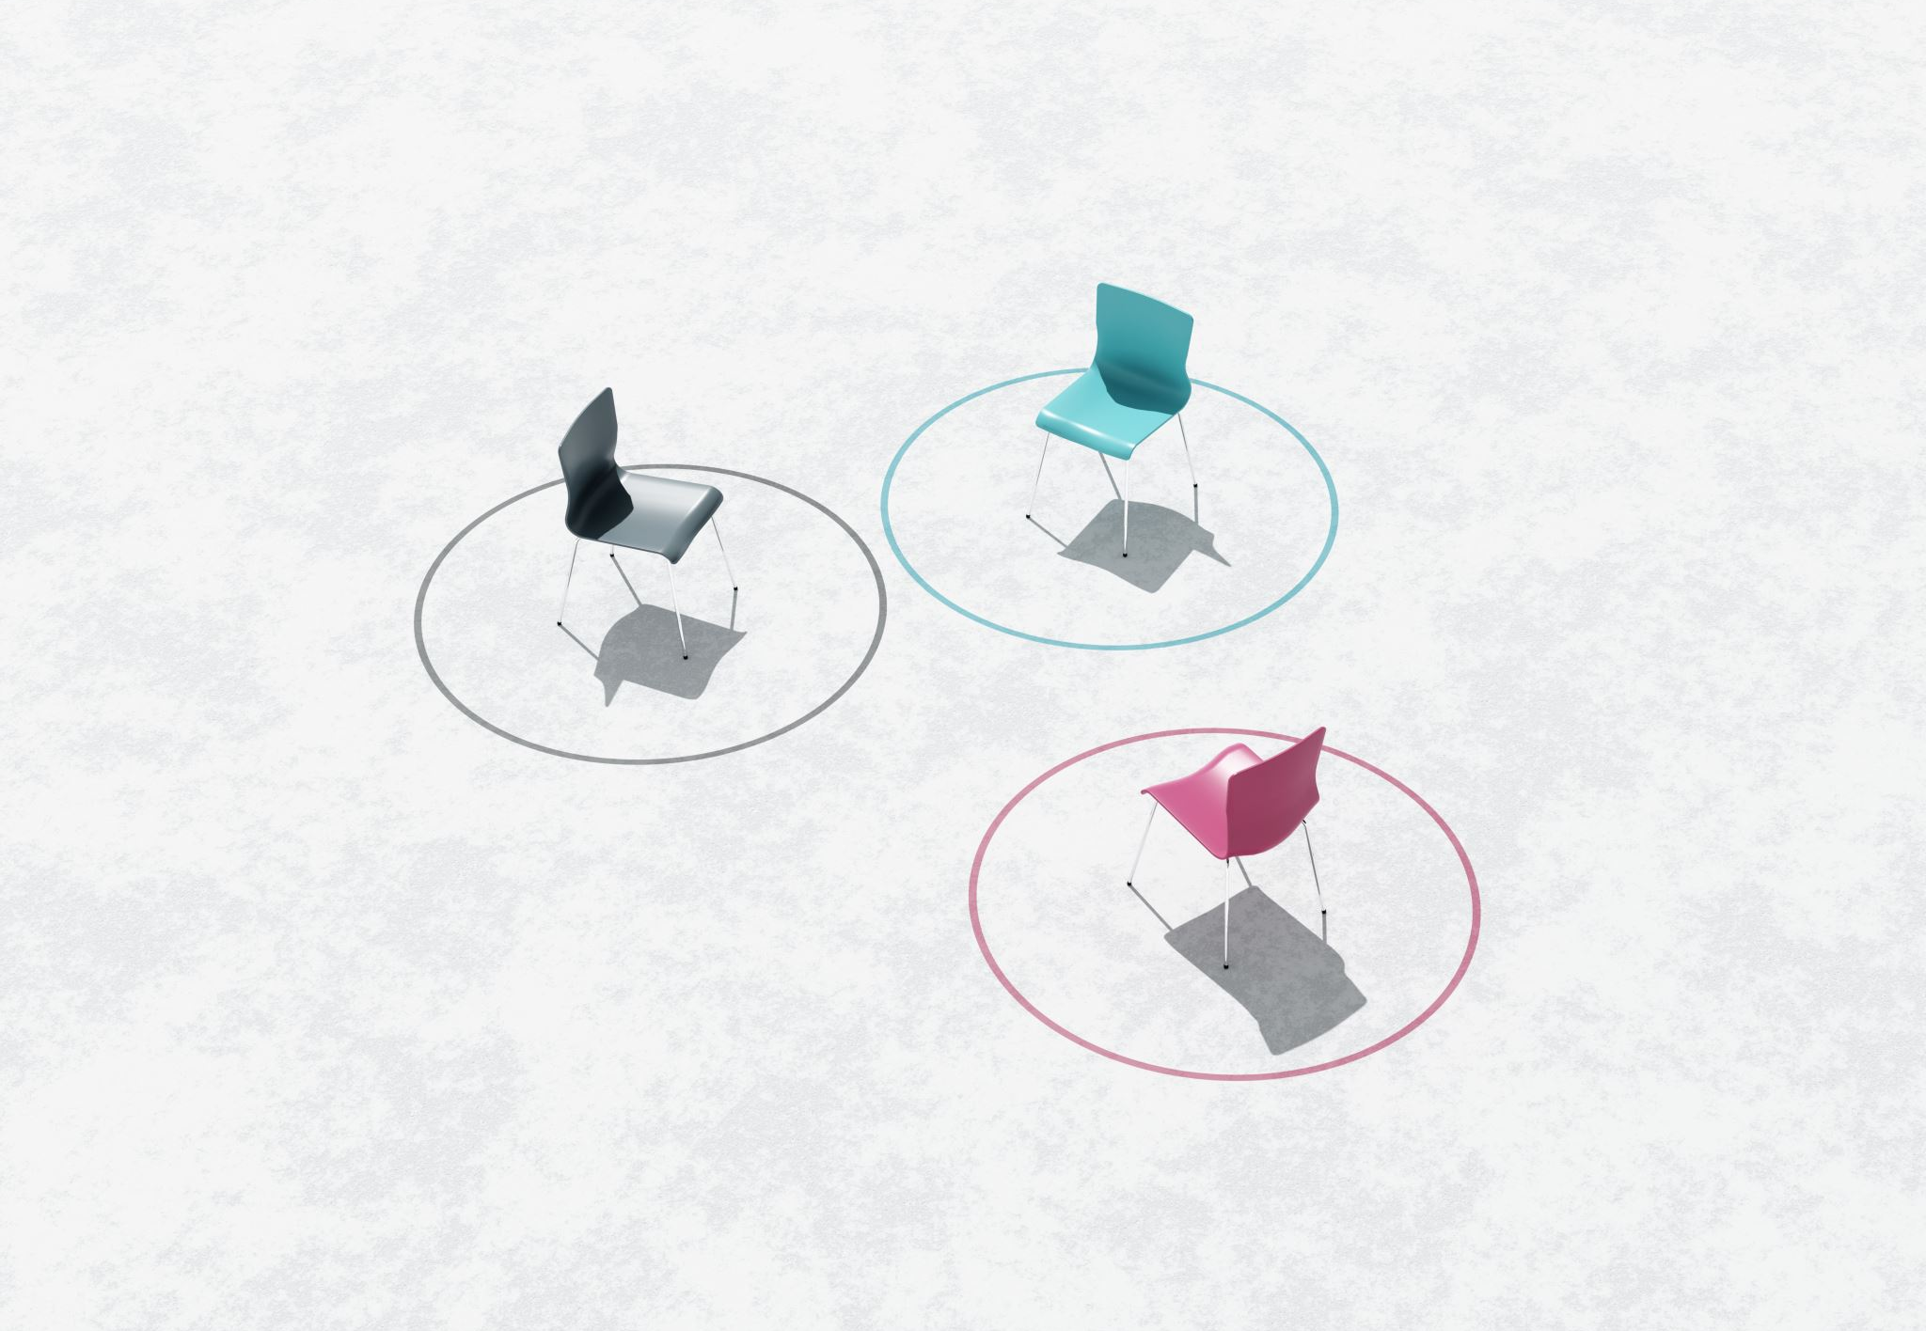
Introduction to Level Design
Level design, an essential aspect of game development that focuses on creating the environments and spaces where gameplay takes place. Level design involves the arrangement of objects, enemies, obstacles, and other elements to create an engaging and enjoyable experience for the player.

Slide 14
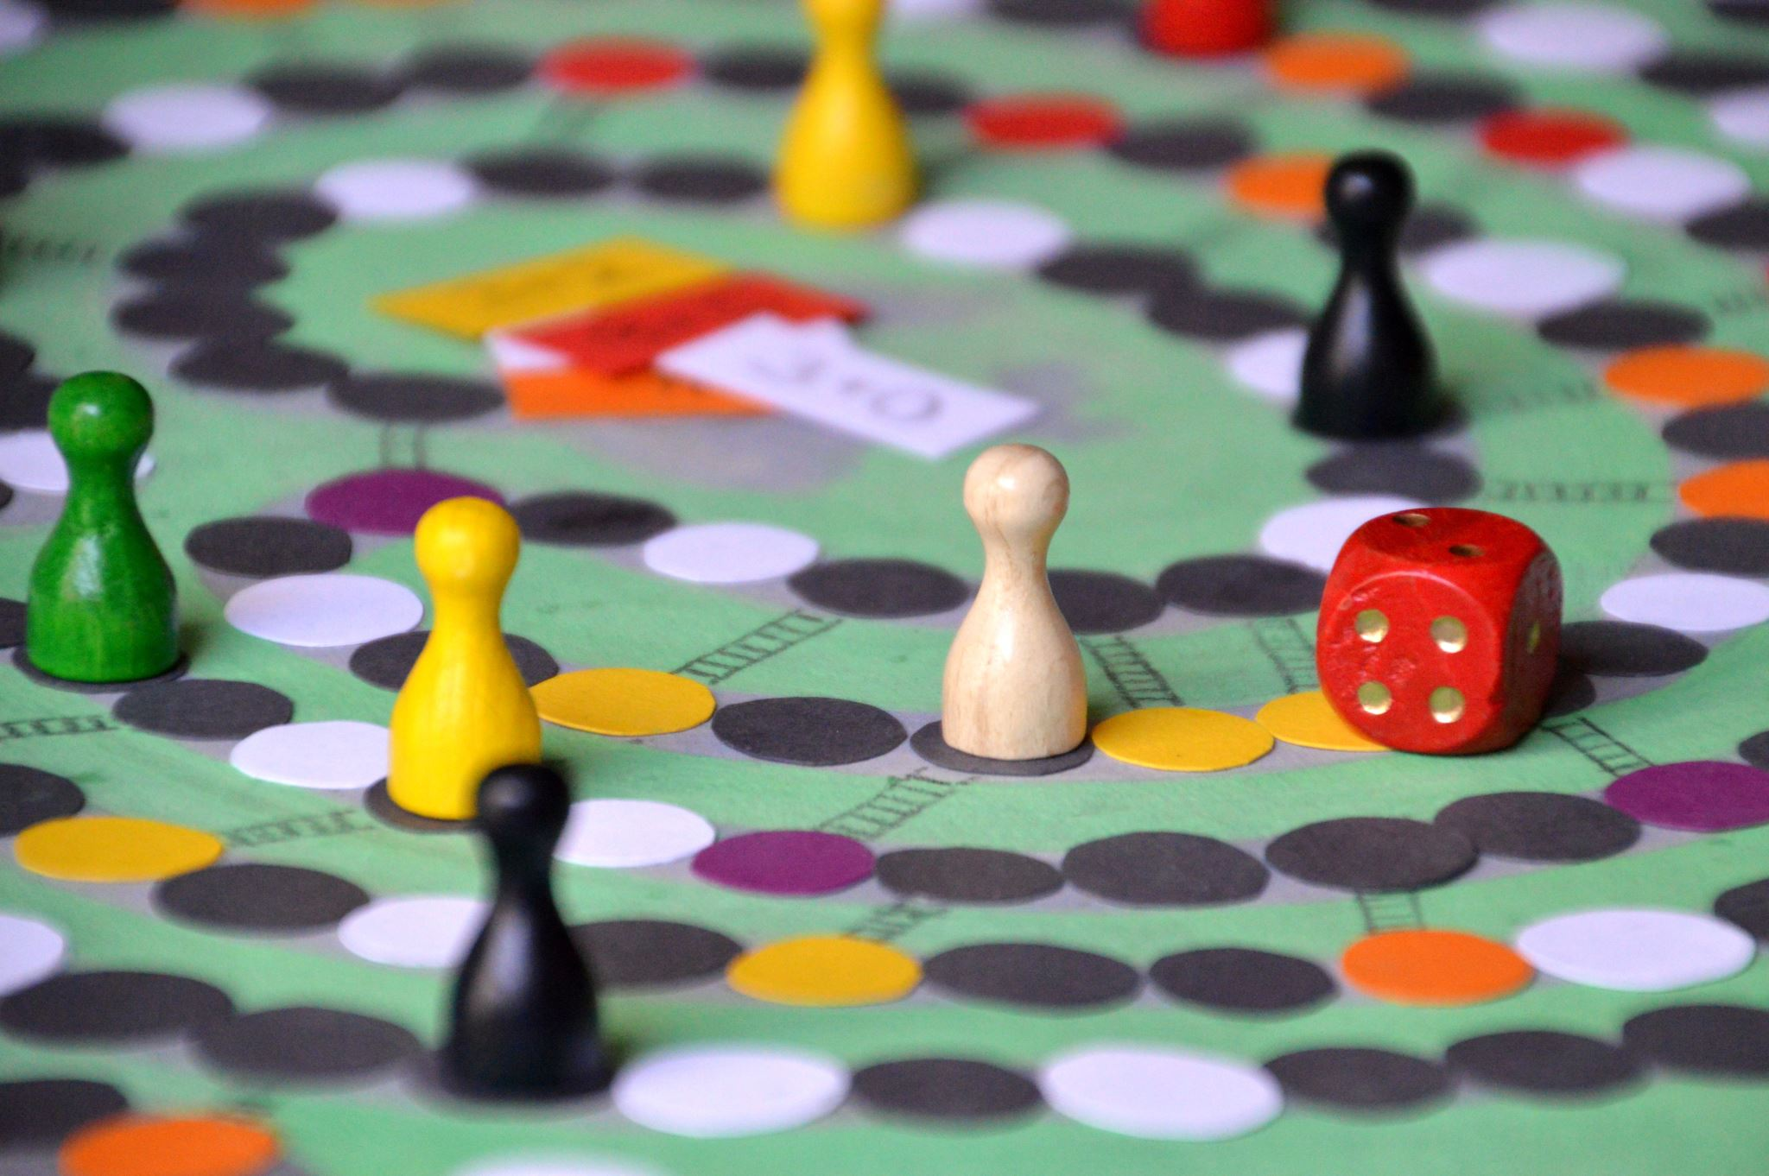
Importance of Level Design
Level design plays a crucial role in guiding players through a game and helping them understand its mechanics, objectives, and narrative. Well-designed levels can:
Provide a sense of progression and achievement.
Create immersive and memorable experiences.
Enhance the game's atmosphere and emotional impact.
Encourage exploration and discovery.

Slide 15

Key Principles of Level Design
When designing levels, it's important to keep several key principles in mind:
Flow: Ensuring that players can navigate the level smoothly and intuitively, without getting lost or frustrated.
Pacing: Balancing periods of high intensity, such as combat or challenges, with moments of calm and exploration to create a satisfying rhythm.
Environmental storytelling: Using the game environment to convey narrative elements and create a sense of history and context.
Player guidance: Providing visual and auditory cues to help players understand their objectives and find their way through the level

Slide 16
Level Design Techniques
Level designers use various techniques to create engaging and enjoyable levels, such as:
Landmarks: Placing distinct, recognizable objects or structures that can help players orient themselves and navigate the environment.
Gating: Using barriers or obstacles to control the player's progression, guiding them along a specific path or requiring them to complete specific tasks to advance.
Level geometry: Designing the layout of the level to create interesting gameplay opportunities, such as cover for combat or platforms for platforming challenges.
Lighting and color: Utilizing lighting and color to guide the player's attention, create a mood, or highlight important areas.

Slide 17
Examples of Well-Designed Levels

Slide 18
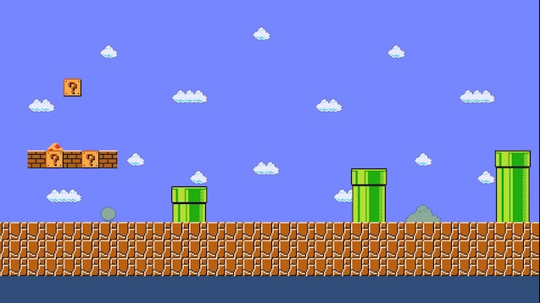
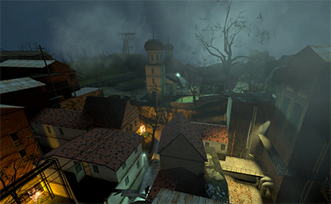
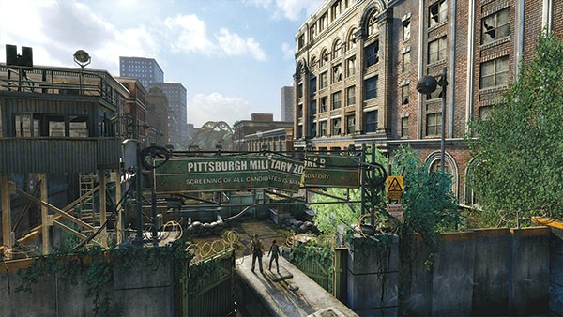
Examples of Well-Designed Levels
Super Mario Bros.
World 1-1:
Half-Life 2 - Ravenholm:
The Last of Us - Pittsburgh:

Slide 19
Introduction to Render Pıpelınes in Unity
A render pipeline in Unity is a series of processes and techniques used to render graphics in a game or application. It defines how the engine processes graphical elements, such as meshes, textures, and materials, to produce the final image displayed on the screen. The render pipeline is responsible for handling various tasks such as rendering shadows, reflections, global illumination, and post-processing effects.

Slide 20
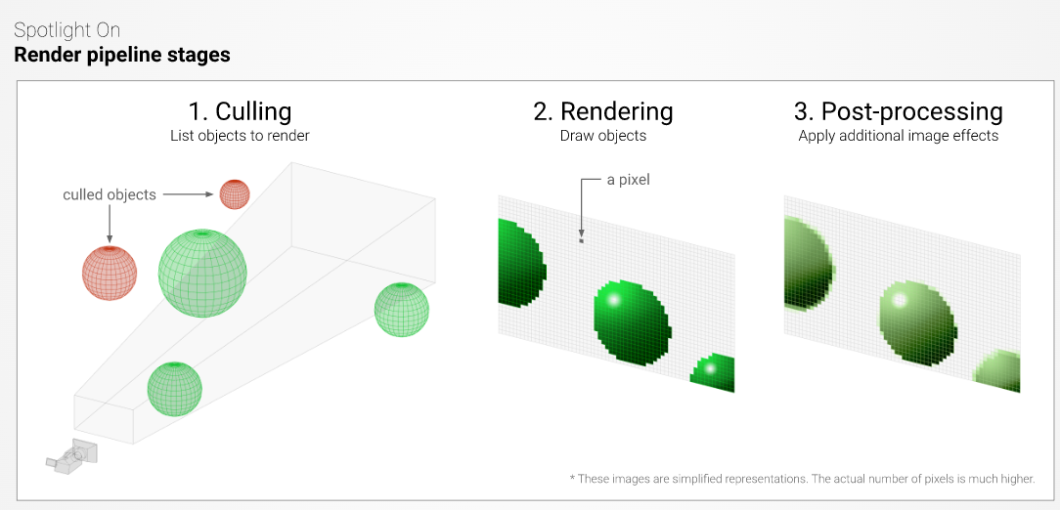

Slide 21
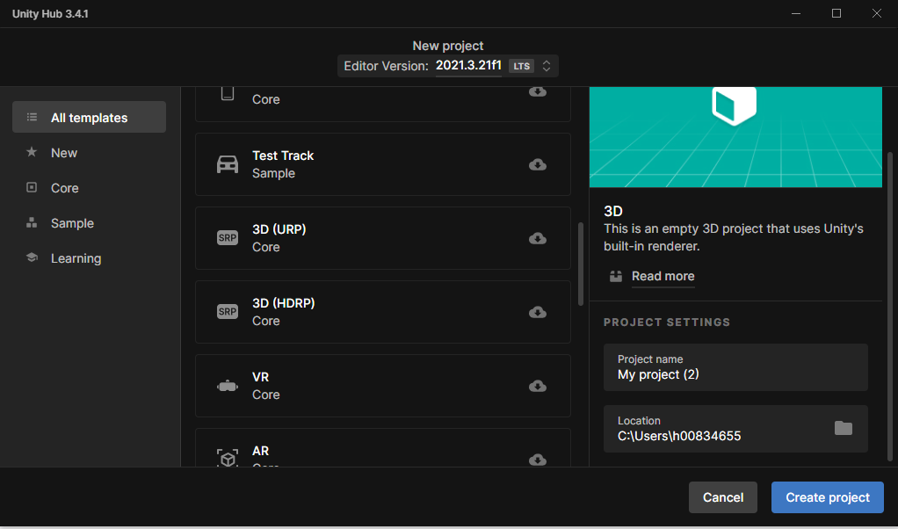

Slide 22
Built-in Render Pipeline
The Built-in Render Pipeline is the default pipeline available in Unity versions prior to 2019.3. It offers a good balance between visual quality and performance and is suitable for a wide range of projects.
Unity versions: Prior to 2019.3
Features: Forward & Deferred rendering, post-processing effects, global illumination, etc.
Target platforms: PC, consoles, mobile, VR, and more
Best for: Small to medium-sized projects, developers new to Unity, or projects targeting multiple platforms.

Slide 23
Universal Render Pipeline (URP)
The Universal Render Pipeline (URP) is designed for projects targeting multiple platforms, including mobile, VR, and more. URP offers improved performance, scalability, and graphics quality over the Built-in Render Pipeline.
Unity versions: 2019.3 and later
Features: Physically-based rendering, Shader Graph, post-processing effects, 2D lights, etc.
Target platforms: PC, consoles, mobile, VR, and more
Best for: Projects targeting multiple platforms, mobile-first projects, or projects requiring high performance.

Slide 24
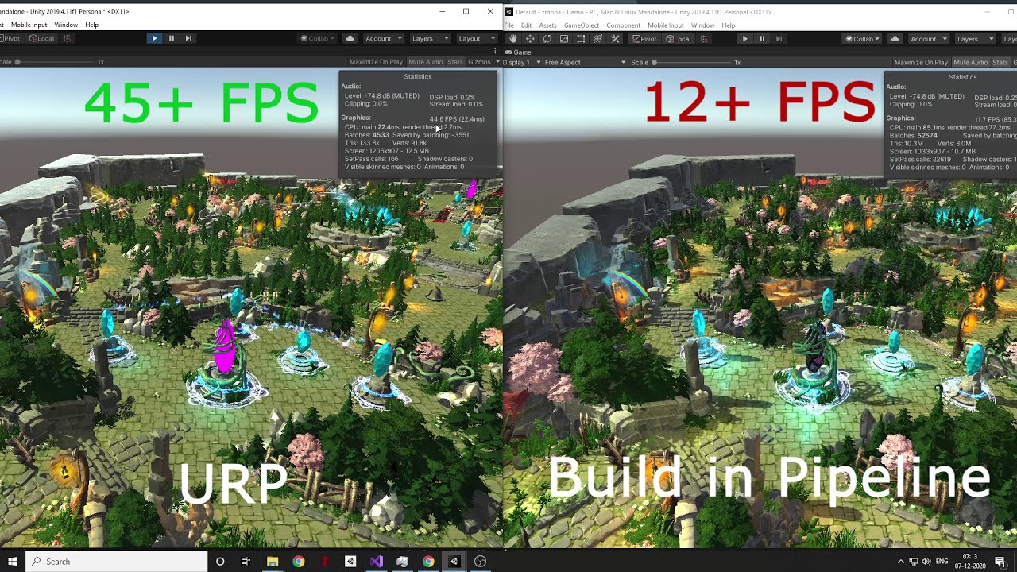

Slide 25
High Definition Render Pipeline (HDRP)
The High Definition Render Pipeline (HDRP) is designed for projects targeting high-end platforms, such as PC and consoles. HDRP offers advanced graphics features, improved visual fidelity, and customizable rendering settings.
Unity versions: 2018.1 and later
Features: Physically-based rendering, Shader Graph, post-processing stack, advanced lighting, Volumetric Fog, etc.
Target platforms: High-end PC, consoles
Best for: Projects requiring high visual fidelity, cinematic experiences, or projects targeting high-end platforms

Slide 26
the right render pipeline
To choose the right render pipeline for your project, consider the following factors:
Target platforms: Ensure the chosen pipeline is compatible with your target platforms.
Project size & complexity: Smaller projects may benefit from the simplicity of the Built-in pipeline, while larger projects may require the advanced features of URP or HDRP.
Performance & visual quality: Balance performance and visual quality based on your project's needs.
Compatibility: Check the Unity version compatibility and required packages for each pipeline

Slide 27
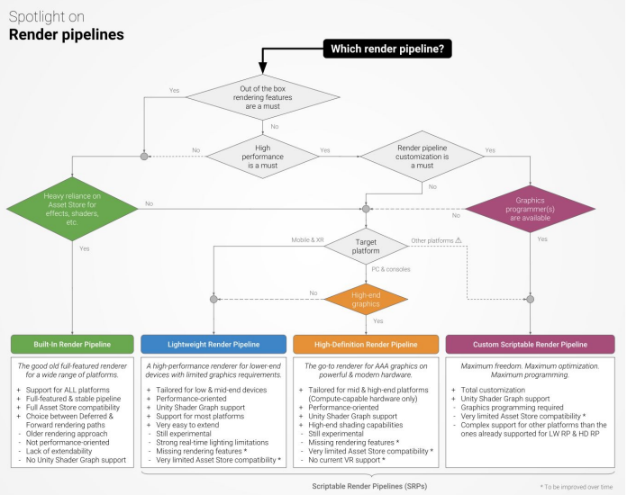

Slide 28

Introduction to Lighting in Unity
Lights in Unity, an essential aspect of game development that contributes to the overall visual appeal and atmosphere of a game. Lighting plays a crucial role in creating immersive environments, guiding players through levels, and enhancing the overall aesthetic of a game.

Slide 29
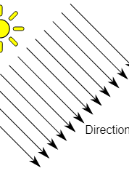
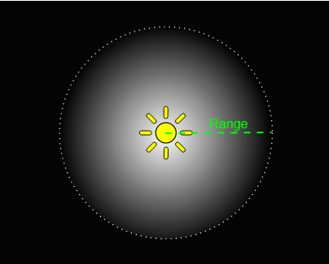
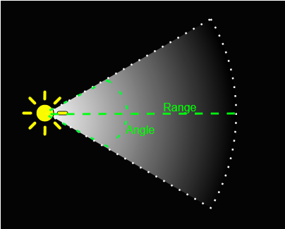
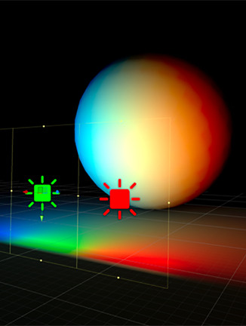
Types of Lights in Unity
Directional Light
Point Light
Spot Light
Area Light
-Only HDRP

Slide 30
Lighting Properties
The type of shadows cast by the light source, such as hard or soft shadows.
COLOR
The color of the light emitted by the light source
INTENSITY
The brightness of the light
The distance the light travels from the light source.
SHADOWS
RANGE

Slide 31
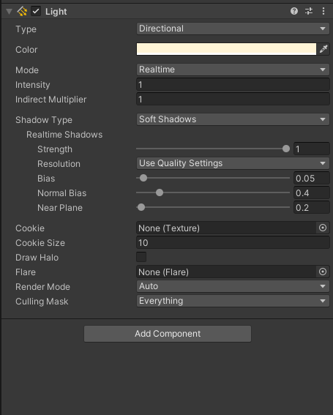
Lighting Properties

Slide 32
Real-time vs. Baked Lighting
Baked
Real-Time
Lighting calculations are performed in real-time during gameplay, allowing for dynamic light sources and shadows. This approach can be more computationally expensive, impacting performance on some devices.
Lighting calculations are precomputed and stored as texture maps during the design process. This approach is more performance-friendly, as it reduces the computational load during gameplay. However, it is not suitable for dynamic light sources or moving objects

Slide 33
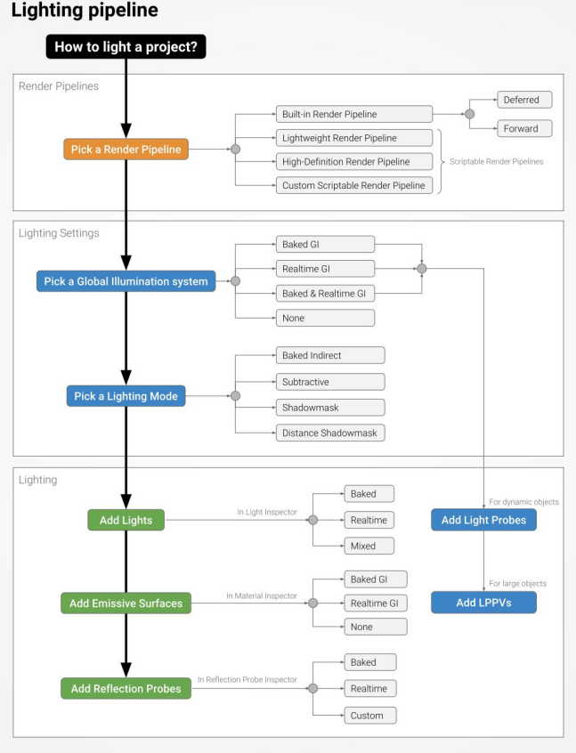

Slide 34
Lighting Tips and Techniques
Here are some tips and techniques to help you create effective lighting in your unity projects:
Use a mix of real-time and baked lighting to balance performance and visual quality.
Combine different types of lights to create more realistic and interesting lighting effects.
Use global illumination to enhance the realism of your scenes.
Adjust light properties such as color, intensity, and range to achieve the desired atmosphere and mood.

Slide 35

Introduction to Fog in Unity
Fog in Unity, an essential aspect of game development that contributes to the overall atmosphere and depth of a game. By adding fog to your game environments, you can create a more immersive and visually appealing experience for your players.

Slide 36

Importance of Fog
Fog plays a crucial role in creating visually interesting and engaging game environments. Some benefits of using fog in your Unity projects include:
Enhancing the atmosphere and mood of a scene.
Adding a sense of depth and distance to the environment.
Concealing distant objects or terrain, improving performance.
Guiding the player's focus and attention.

Slide 37
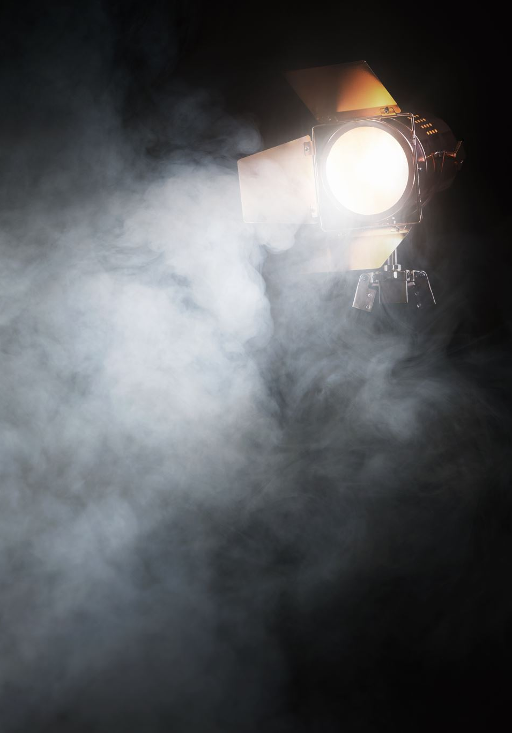
Creating Fog in Unity
In Unity, fog can be added to your game scenes through the Lighting settings. To enable and customize fog, follow these steps:
Navigate to Window > Rendering > Lighting Settings.
In the Lighting Settings window, locate the 'Fog' section.
Check the 'Fog' checkbox to enable fog in your scene."

Slide 38
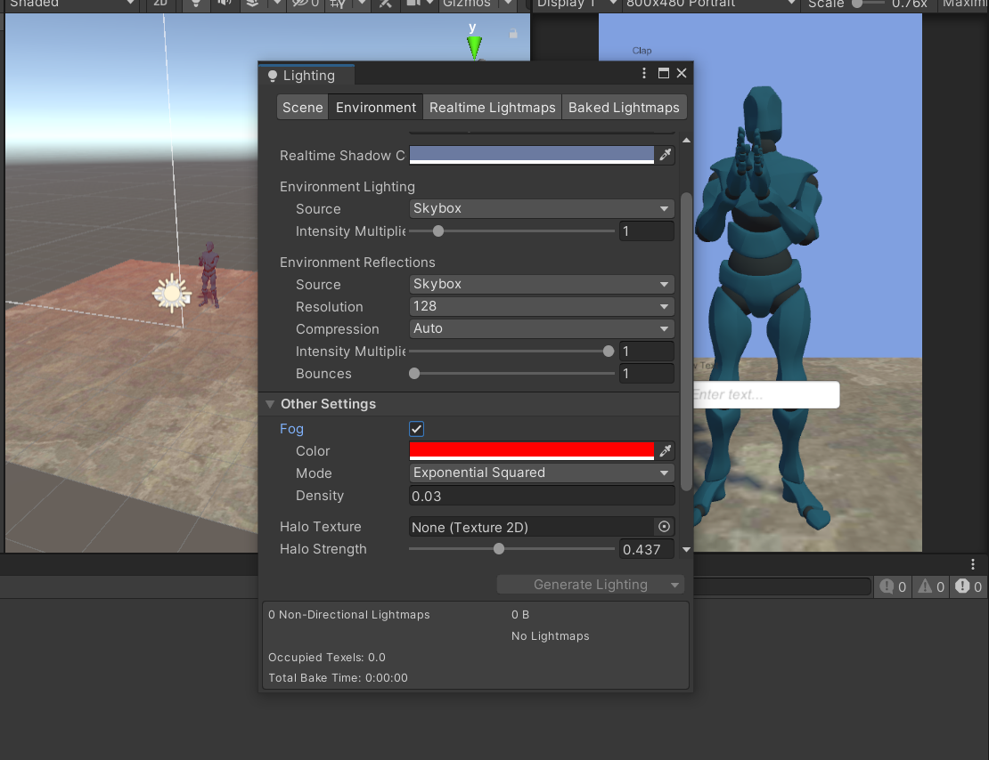

Slide 39

Fog propertıes
Once you've enabled fog in Unity, you can adjust several properties to achieve the desired appearance and behavior:
Fog Mode: Choose between Linear, Exponential, and Exponential Squared fog modes to control how fog density increases with distance.
Fog Color: Set the color of the fog to blend with your scene's environment and enhance the overall atmosphere.
Fog Density: Control the overall density of the fog and how quickly it becomes opaque (applicable for Exponential and Exponential Squared fog modes).
Start and End Distance: For Linear fog mode, set the start and end distances to control the range over which the fog appears and fades.

Slide 40

Tips for Using Fog Effectively
To get the most out of using fog in your Unity projects, consider these tips:
Use fog color to match your scene’s overall tone and atmosphere.
Experiment with different fog modes to find the one best suits your environment.
Balance fog density and distance to completely avoid obscuring important objects or gameplay elements.
Use fog in combination with other visual effects, such as lighting and post-processing, to create a cohesive and engaging visual experience.

Slide 41
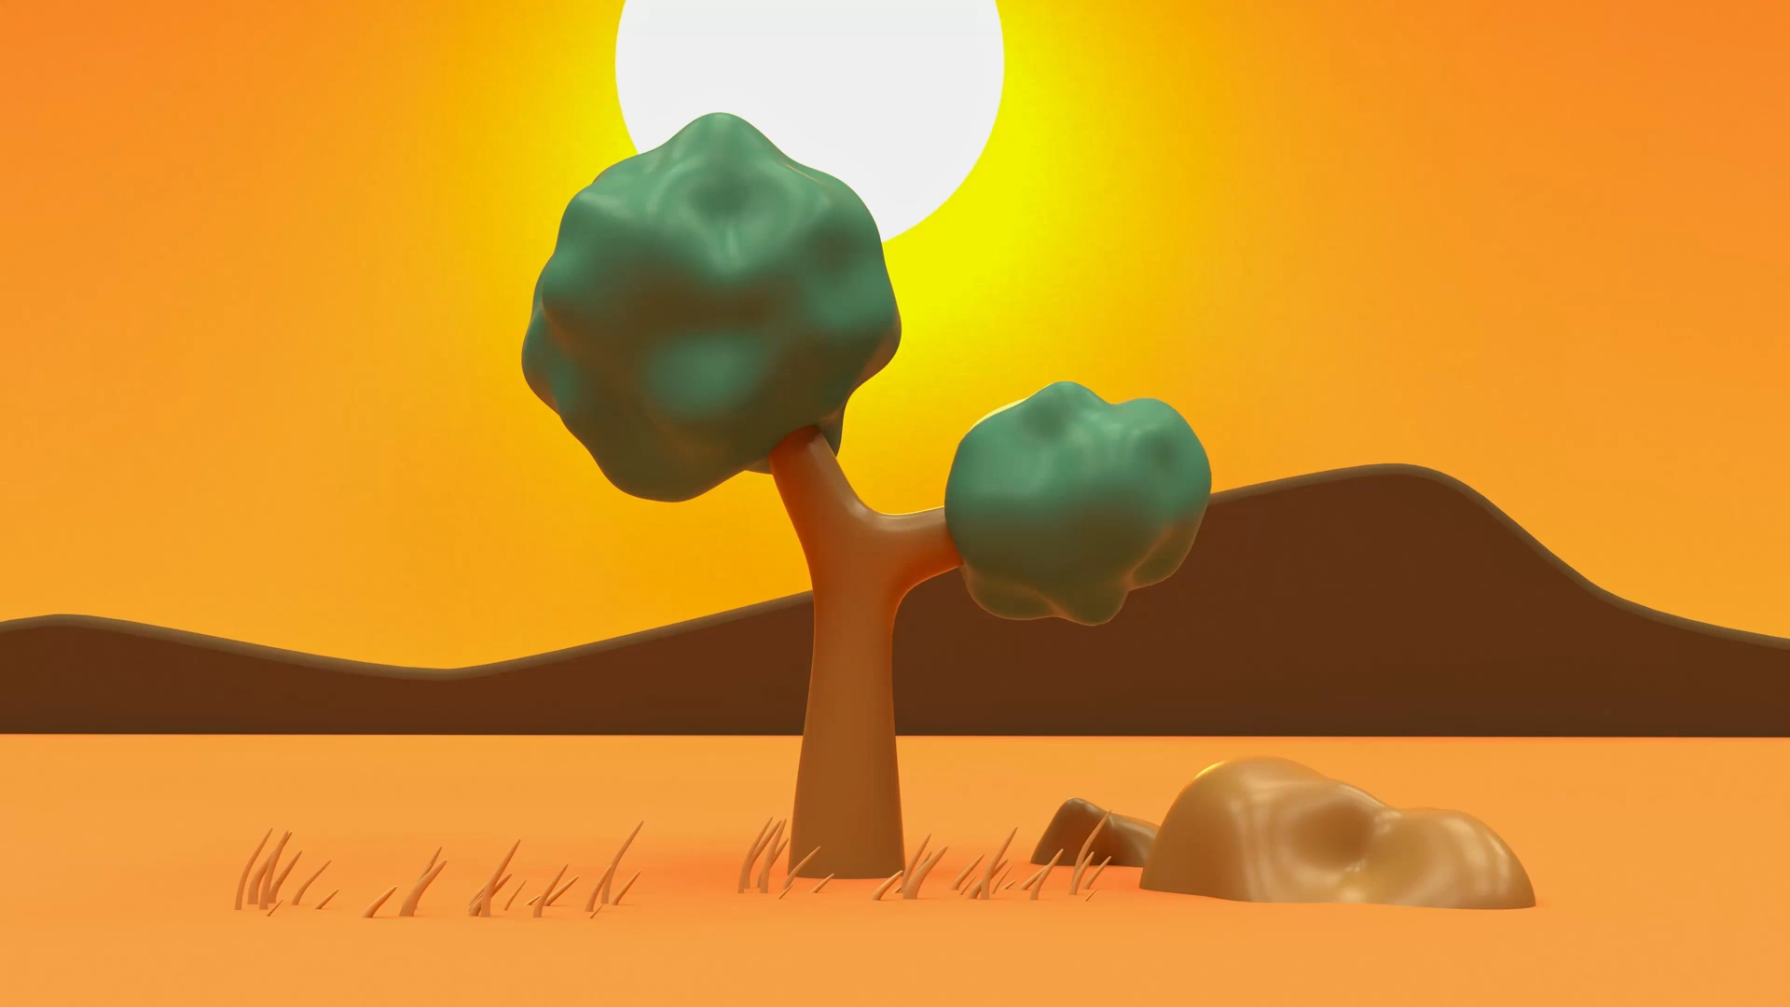
Introduction to Skyboxes in Unity
Skyboxes in Unity, are an essential aspect of game development that contributes to the overall visual appeal and atmosphere of a game. Skyboxes allow you to create immersive and realistic environments by simulating distant objects like the sky, clouds, or mountains

Slide 42
What is a Skybox?
A skybox is a 3D cube or sphere that surrounds the entire game environment and displays a panoramic texture on its inner surfaces. This texture represents distant objects and scenery, creating the illusion of depth and distance in the game world. Skyboxes can significantly enhance the visual appeal of your game and create a more immersive experience for your players.

Slide 43

Creating Skyboxes in Unity
In Unity, you can create and customize skyboxes using two main approaches:
Default Skybox: Unity provides a default skybox that can be customized by adjusting its colors and gradients to match your desired environment.
Custom Skybox: Import your own panoramic textures or create them using external tools, and apply them as a skybox material in Unity

Slide 44
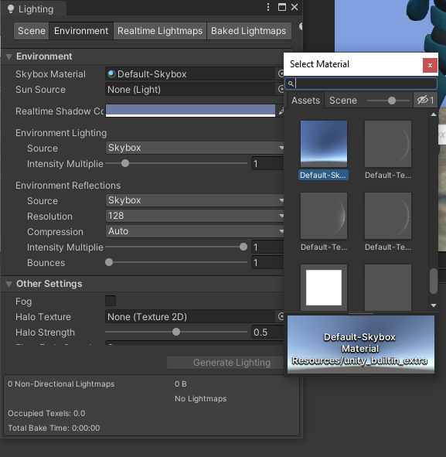
Assigning a Skybox in Unity
Go to Window > Rendering > Lighting Settings.
In the Lighting Settings window, locate the 'Environment' section.
Under 'Skybox Material,' click the small circle next to the input field to bring up the material selection window.
Choose the desired skybox material from the list, or import and select your custom skybox material.

Slide 45
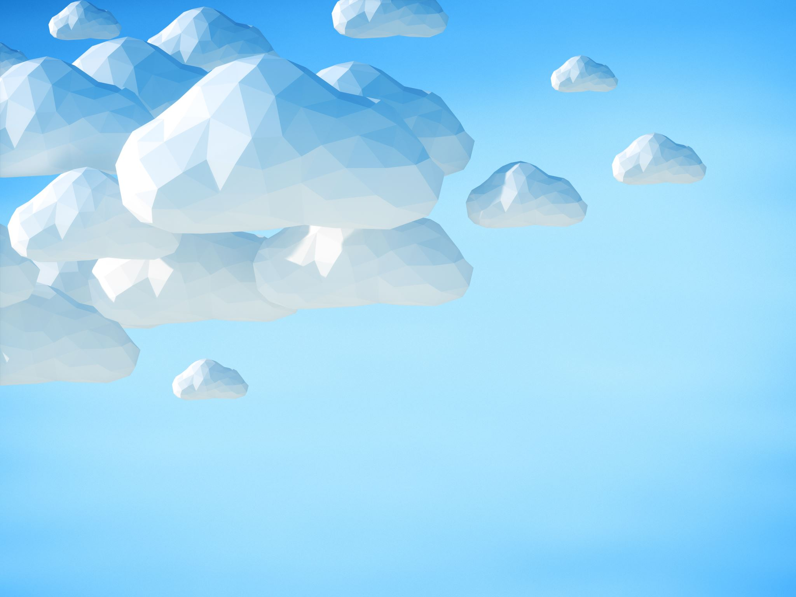
Tips for Creating Effective Skyboxes
To create visually appealing and engaging skyboxes for your Unity projects, consider these tips:
Choose high-quality panoramic textures for custom skyboxes to ensure a realistic and immersive environment.
Make sure your skybox texture seamlessly wraps around the environment to avoid visible seams or edges.
Match the lighting and colors in your scene to the skybox for a cohesive and consistent visual experience.
Use skyboxes in combination with other environmental elements, such as terrain, fog, and lighting, to create a well-rounded and immersive game world.

Slide 46
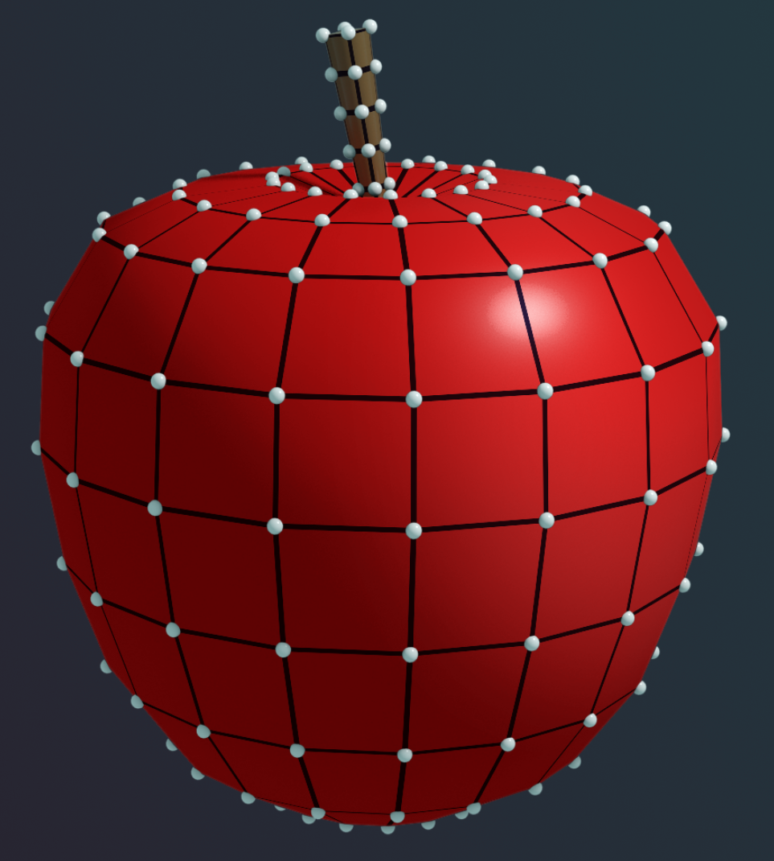
Introduction to Shaders in Unity
Shaders are an essential aspect of the use of shaders ame development that determines the appearance of materials and surfaces in your game. Shaders play a crucial role in creating visually appealing and immersive environments by defining how light interacts with objects in your scene

Slide 47
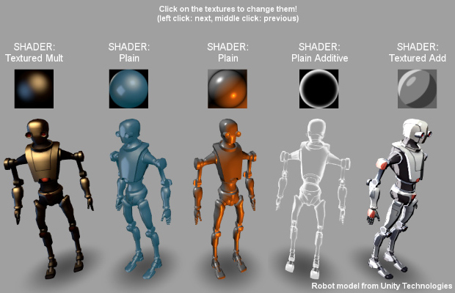
What are Shaders?
Shaders are small programs that run on the GPU and define the appearance of materials and surfaces in your game. They control how light interacts with objects, producing various visual effects and rendering styles. Shaders can be used to create a wide range of appearances, from realistic materials like metal or glass to stylized, cartoon-like surfaces.

Slide 48
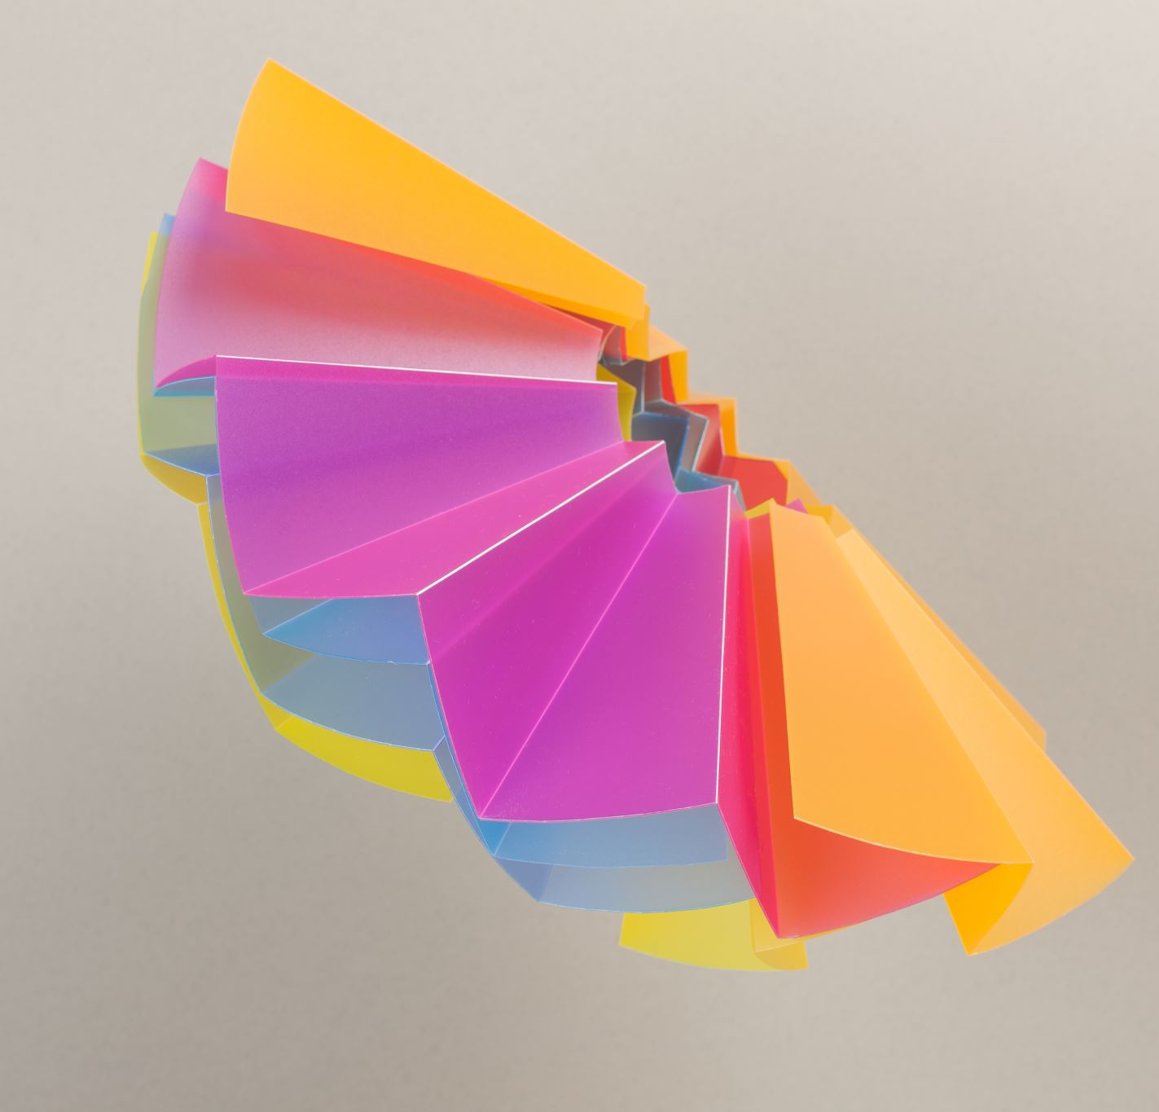
Buılt-ın Shaders ın Unıty
Unity offers a variety of built-in shaders that you can use in your projects. Some popular built-in shaders include:
Standard Shader: A versatile shader that supports various material properties like albedo, specular, normal maps, and more. It is suitable for a wide range of applications and rendering styles.
Mobile Shader: Optimized shaders designed for use on mobile devices, offering better performance with lower visual fidelity.
Unlit Shader: A simple shader that does not consider lighting, suitable for flat or stylized visuals.
Skybox Shader: A specialized shader for rendering skyboxes in your game environment.

Slide 49
Creating Custom Shaders in Unity
Unity also allows you to create custom shaders using different approaches:
ShaderLab: Unity's shader scripting language that allows you to create shaders using code. ShaderLab scripts define the behavior of shaders through a combination of properties, sub-shaders, and shader passes.
Shader Graph: A visual node-based editor available in Unity's Scriptable Render Pipelines (SRP), such as the Universal Render Pipeline (URP) and the High Definition Render Pipeline (HDRP). Shader Graph enables you to create custom shaders without the need for coding, making it more accessible for artists and designers.

Slide 50
SHADER GRAPH
Shader Graph is a visual shader editor available in Unity that allows you to create shaders using a node-based interface. To use Shader Graph in your project, follow these steps:
Install Shader Graph and render pipeline package:
Shader Graph is compatible with Unity's Scriptable Render Pipelines (SRP) - Universal Render Pipeline (URP) and High Definition Render Pipeline (HDRP). Ensure that your project is using either URP or HDRP.
To install URP, go to Window > Package Manager, select "Unity Registry" from the dropdown, find "Universal RP" in the list, and click "Install".
To install HDRP, follow the same process, but find "High Definition RP" in the list and install it.

Slide 51
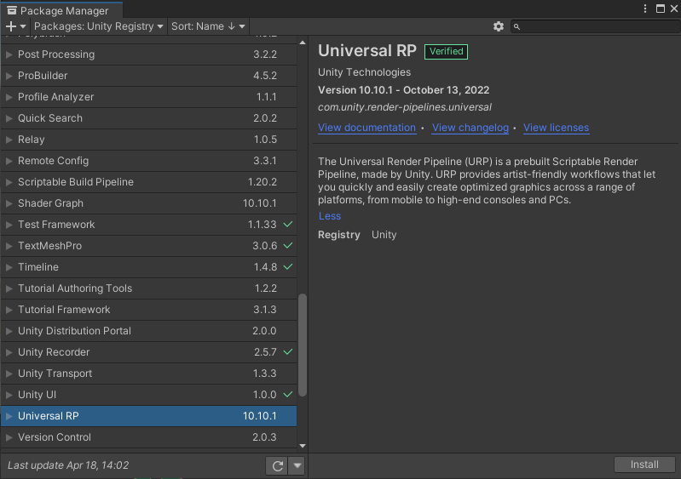
SHADER GRAPH

Slide 52
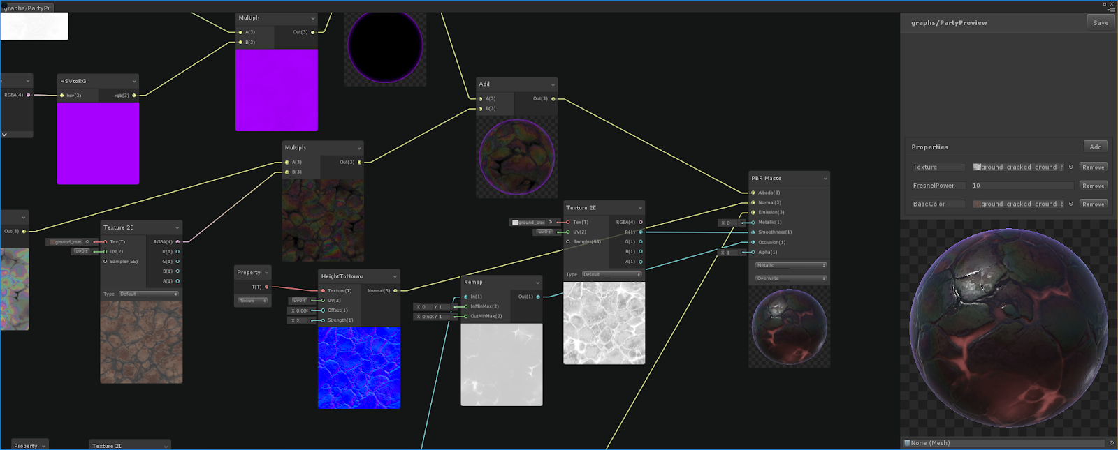
SHADER GRAPH

Slide 53
Thırd party shader tools
Amplify Shader Editor: Amplify Shader Editor is a powerful, node-based shader editor for Unity that allows users to create complex shaders without writing code. It supports a variety of platforms and rendering pipelines, such as Unity's Built-In Render Pipeline, Universal Render Pipeline (URP), and High Definition Render Pipeline (HDRP).
Shader Weaver: Shader Weaver is another node-based shader editor for Unity that enables users to create custom shaders without coding. It focuses on creating 2D shaders, providing a user-friendly interface for designing and developing visually appealing effects for 2D games and projects.
Shadero Sprite: Shadero Sprite is a tool specifically designed for creating 2D shaders and effects in Unity. It offers an intuitive interface that enables users to create and modify shaders and effects directly in the scene view, with real-time previews.

Slide 54
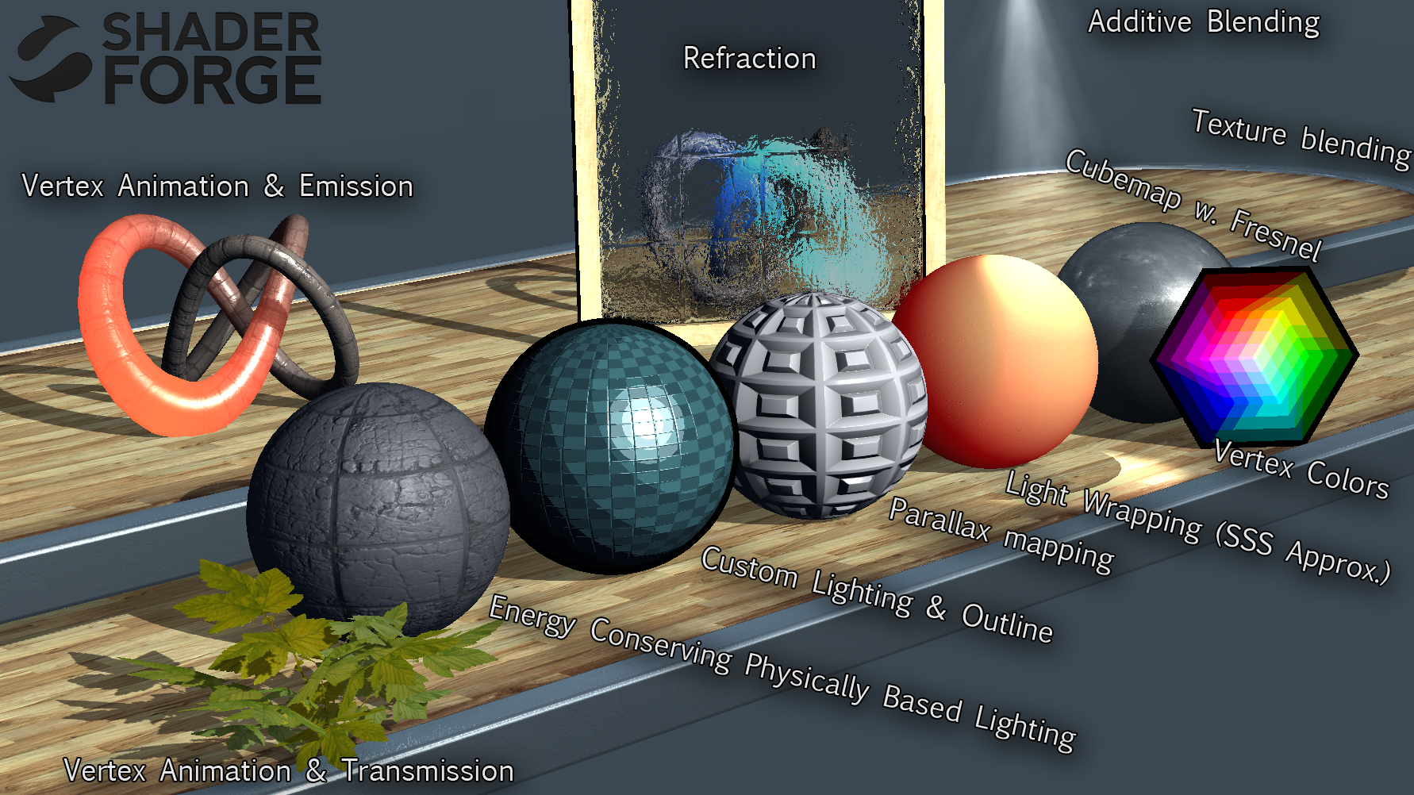
SHADER GRAPH

Slide 55
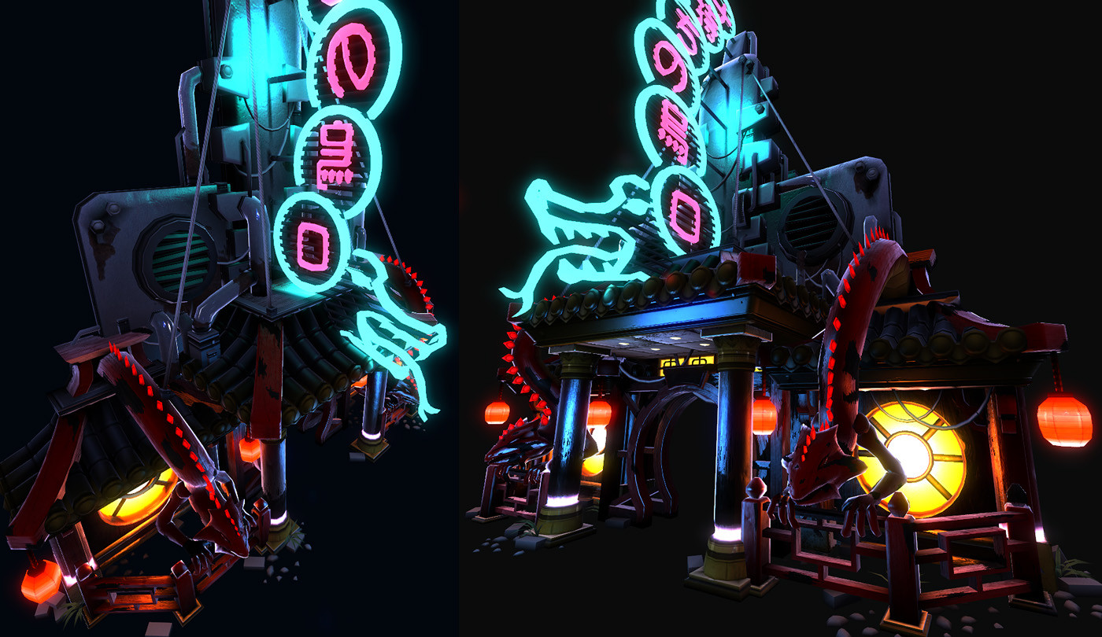

Slide 56
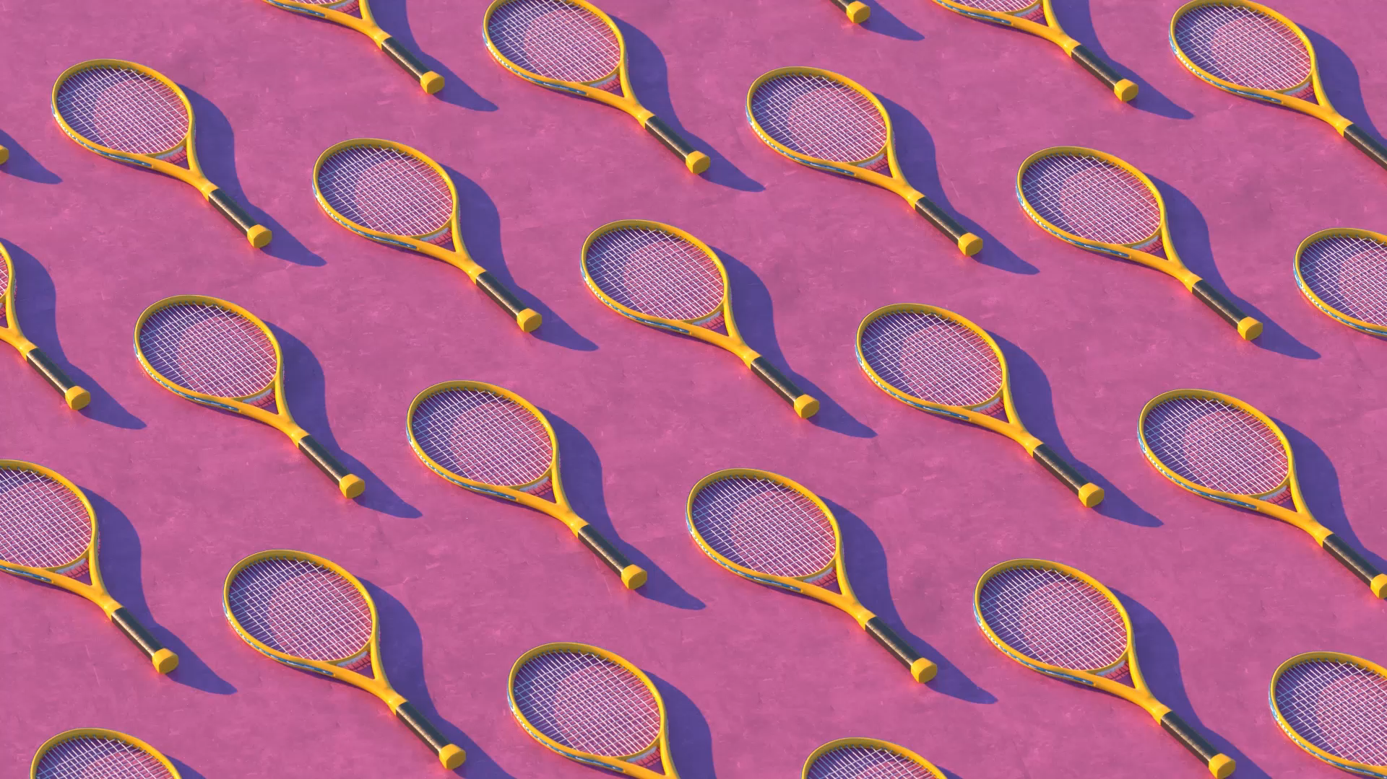
Tips for Creating Effective Shaders
To create visually appealing and efficient shaders for your Unity projects, consider these tips:
Consider performance when creating custom shaders. Complex shaders can be resource-intensive and may impact your game's performance, especially on lower-end devices.
Balance visual fidelity with performance, especially when targeting mobile or less powerful platforms.
Use Shader Graph to create custom shaders without coding, making it more accessible for artists and designers.
Test your shaders on different platforms and devices to ensure consistent appearance and performance.

Slide 57
Introduction to Effects in Unity
Effects in unity, an essential aspect of game development that adds visual flair and enhances the overall experience of your game. Effects can be used to create A wide range of visuals, from particle systems and post-processing to dynamic lighting and more.

Slide 58
Types of Effects in Unity
Unity offers various tools and techniques for creating effects in your game, such as:
Particle Systems: Used to create and manage particle effects like fire, smoke, rain, or magical spells.
Post-Processing: Apply image effects to the final rendered image, enhancing visuals with depth of field, color grading, bloom, and more.
Trail Renderer: Create trails that follow moving objects, useful for visualizing motion or simulating effects like smoke trails or light streaks.
Line Renderer: Render lines between a set of points, suitable for creating effects like laser beams or electrical arcs.
Dynamic Lighting: Use real-time or baked lighting to create realistic and immersive environments.

Slide 59
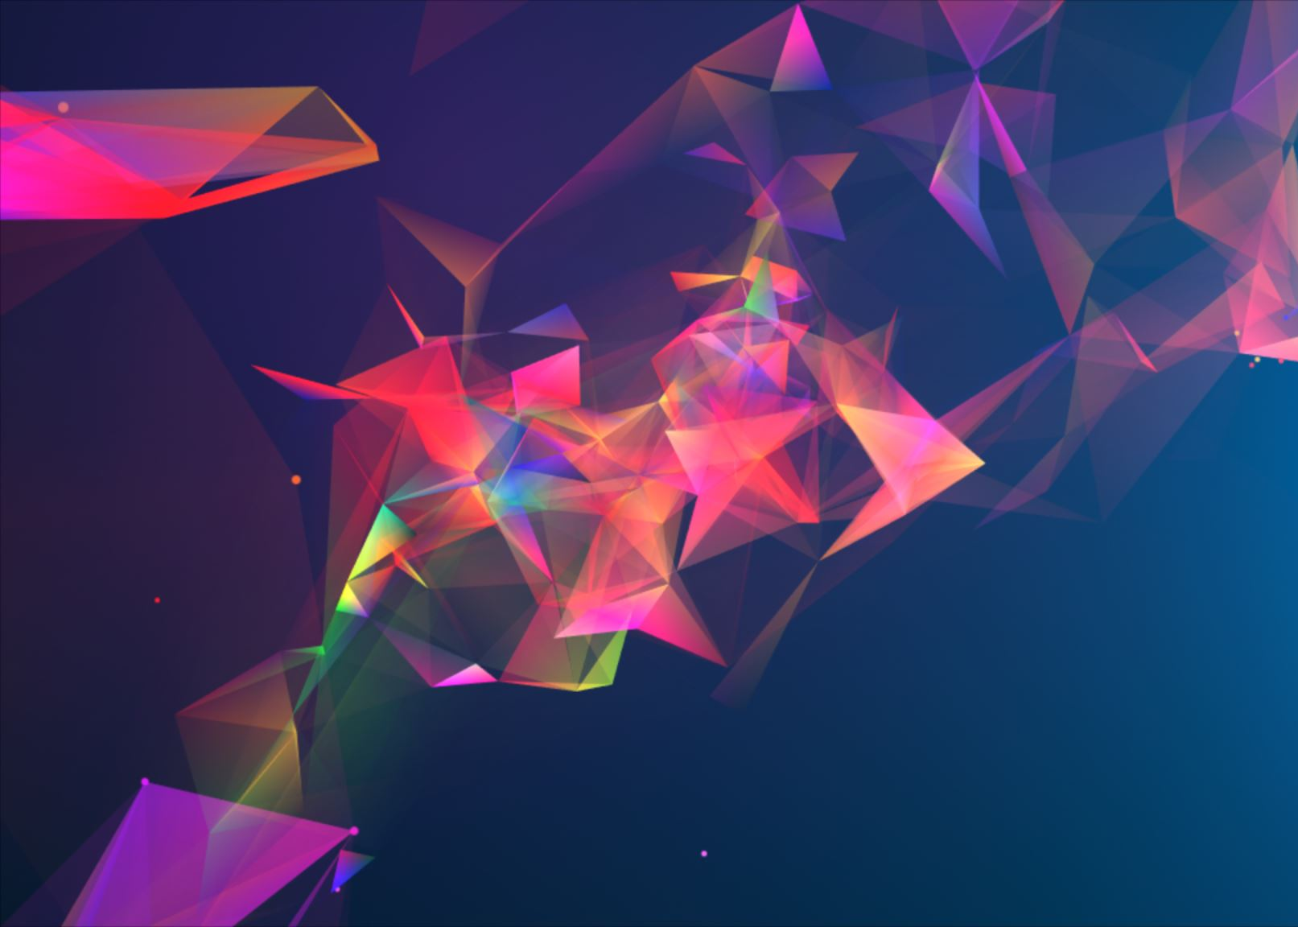
Particle Systems in Unity
Particle systems are a powerful tool in Unity for creating a wide variety of visual effects. To create a new particle system:
Right-click in the Hierarchy panel, and select 'Effects > Particle System.'
Adjust the properties in the Particle System component to customize the appearance, emission rate, size, shape, and more.
Use sub-emitters, collision, and other advanced features to create complex and interactive particle effects.

Slide 60
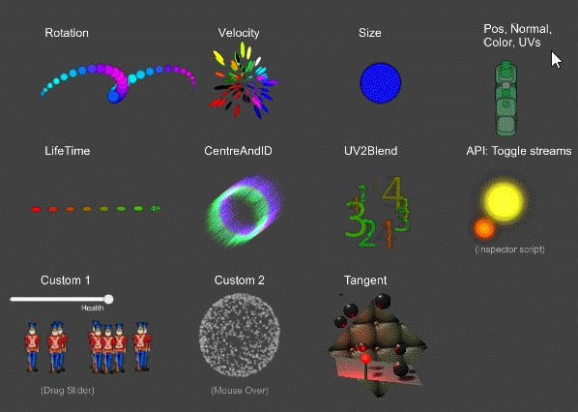

Slide 61
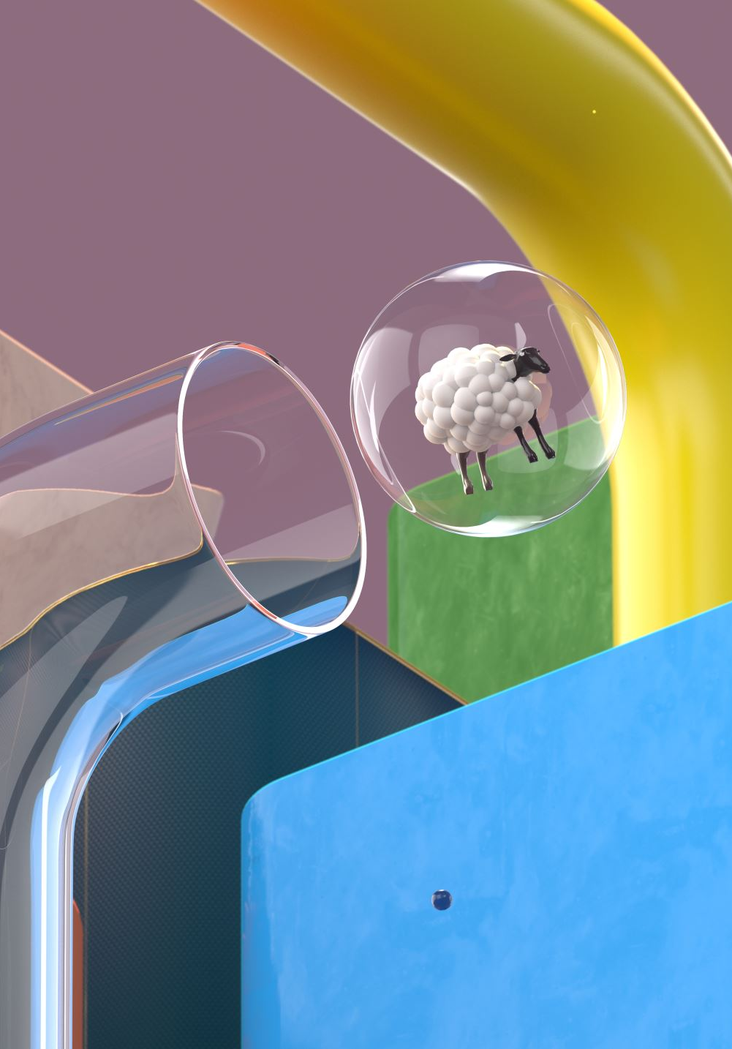
Post-Processing in Unity
Post-processing effects can significantly enhance the visual quality of your game. To use post-processing in Unity:
Install the appropriate post-processing package based on your project's render pipeline (Built-in, URP, or HDRP).
Create a Post-Processing Volume in your scene and assign a Post-Processing Profile.
Add and customize post-processing effects like bloom, depth of field, color grading, and more to the profile.

Slide 62
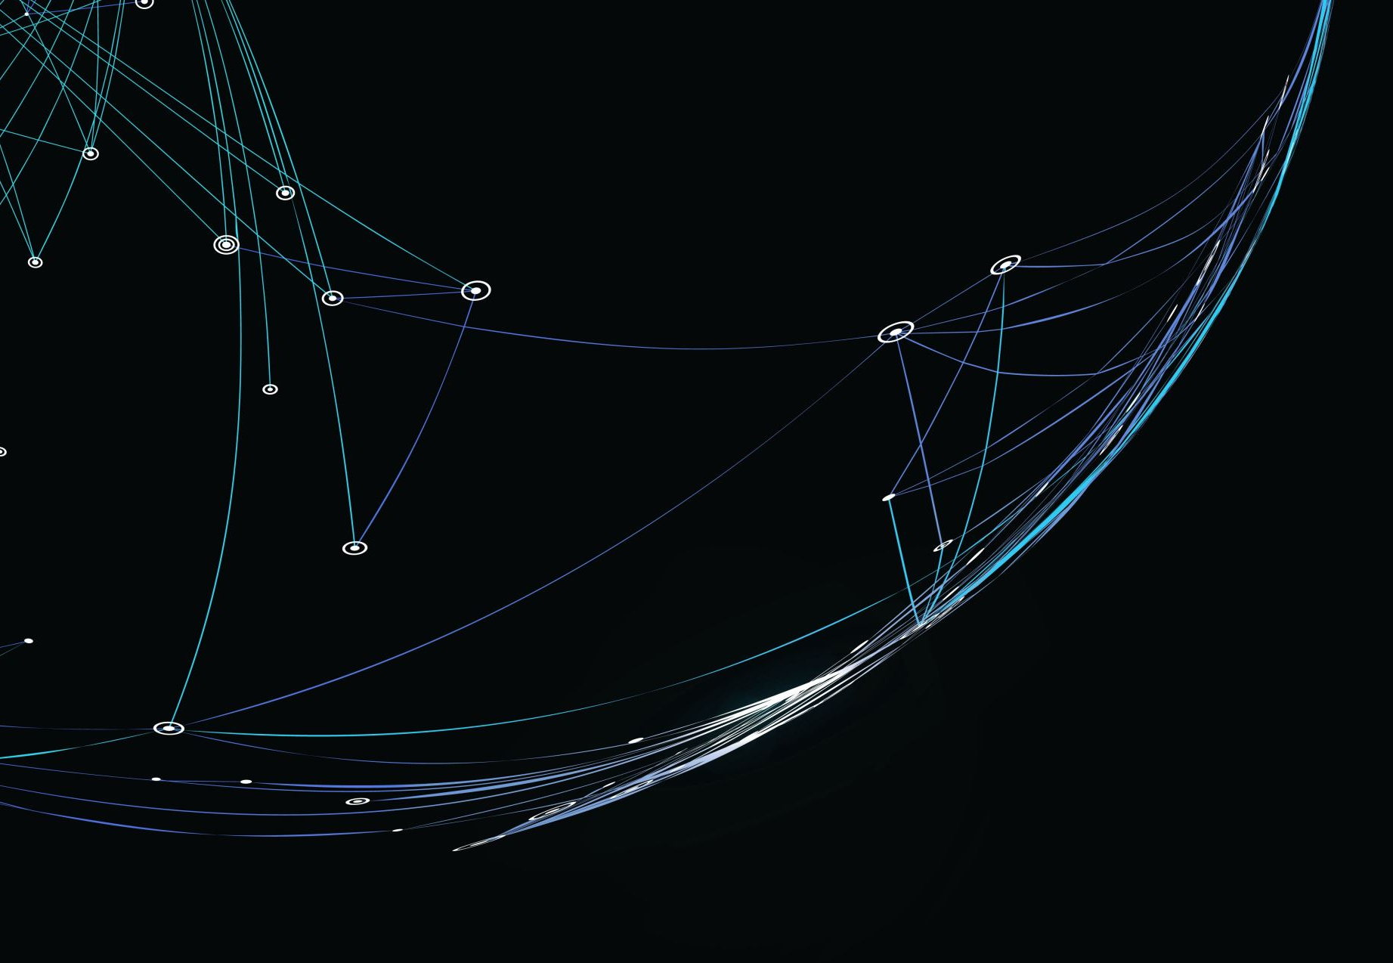
Tips for Creating Effective Effects
To create visually appealing and engaging effects for your Unity projects, consider these tips:
Use effects in moderation and balance them with the overall visual style of your game.
Optimize effects for performance, especially when targeting lower-end devices or platforms.
Combine different types of effects (particle systems, post-processing, etc.) to create unique and visually interesting scenes.
Test your effects on different devices and platforms to ensure consistent appearance and performance.

Slide 63
Conclusion
Utilizing lights, fogs, skyboxes, shaders, and effects in Unity can greatly enhance your game’s visual appeal and immersion.
These elements, when used in conjunction with proper game design and level design, contribute to the overall success of your game.
Remember to balance visual fidelity with performance, especially when targeting a variety of platforms and devices.
Continuously experiment with different combinations of these features to discover unique visual styles and create memorable gaming experiences for your audience.

Slide 64
THANK YOU
Hayriye Hilal Tepecik

